Slide 1

CHILD SAFETY - CLUBS

Slide 2

CHILD SAFE FRAMEWORK AND GUIDELINES
Rugby AU have developed the Child Safe Framework and Safeguarding Children Guidelines that underpin the Member Protection Policy.
The Child Safe Framework outlines Rugby AU’s commitment to child safety and defines roles and responsibilities across the game.
The Safeguarding Children Guidelines outline best practice behaviours when working with children and young people in sport.
Rugby AU recommend all clubs read both the framework and the guidelines and contact your state/territory MPIO if you have any queries.

Slide 3
REPORTING AND CASE MANAGEMENT
In 2018 Rugby AU launched a National Incident Report Form that allows for better, more consistent reporting, this will continue through 2019.
One system to manage cases and child protection cases are re-directed to the relevant Member Protection Information Officer (MPIO) and Rugby AU Integrity Team only.
Your union MPIO is Kerry Brady (KBrady@nswrugby.com.au)
The report form can be found at http://www.rugbyau.com/about/codes-and-policies/reporting-a-concern
If you believe a child is in immediate danger you MUST report this to the police or relevant child services authority
Notes:
The report form is able to securely capture all reports in one system and for highly sensitive cases i.e. child protection matters these are re-directed to the relevant state/territory Member Protection Information Officer (MPIO) and the integrity team at Rugby AU
MPIO’s are training in how to manage complex or highly sensitive member protection matters

Slide 4
TRAINING AND EDUCATION
Each club must have a Member Protection Contact (MPC) who has completed the MPC Accreditation in the Rugby Learning Centre and have this role assigned in Rugby Xplorer.
Your club members should know who the MPC is. You can use flyers/posters from the Rugby AU Child Safety webpage or your home union’s webpage.
The MPC training covers:
  Code of Conduct
  Member Protection and Inclusion
  Requires a valid WWCC

Slide 5

CREATING CHILD SAFE ENVIRONMENTS
Talk about our commitment to keeping children and young people safe openly and often
Recruit suitable people
Clear rules and guidelines about how our people should behave with children and young people – Code of Conduct, Member Protection Policy – Safeguarding Guidelines
Training / Education
Clear processes for reporting concerns
Engage children and young people and their families in the conversation e.g. talk about child safety at your pre-season meetings

Slide 6
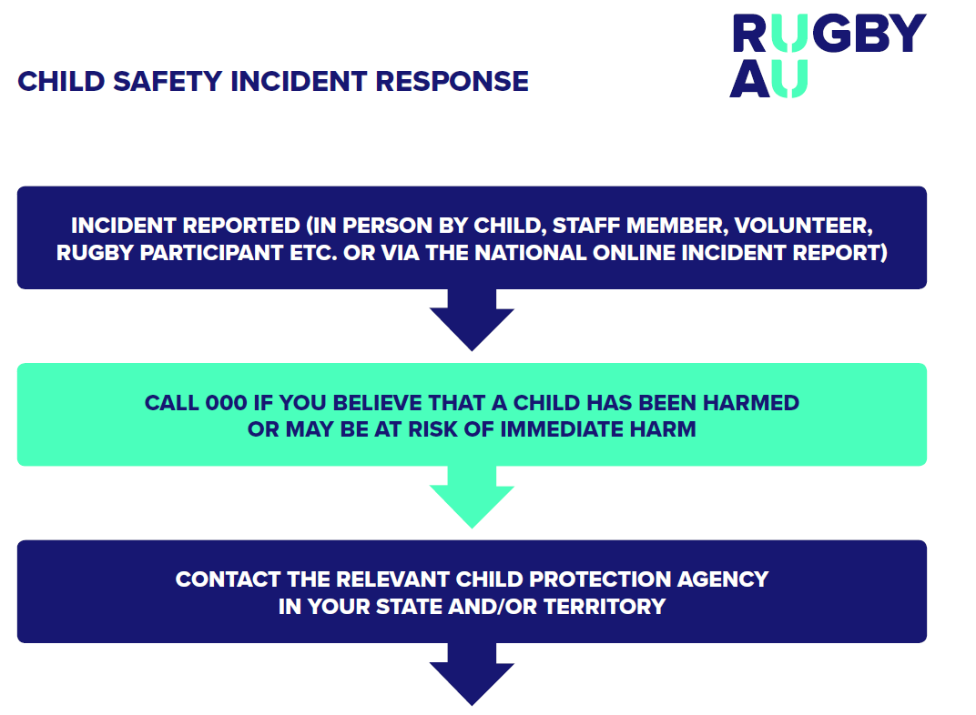
CHILD SAFETY RESOURCES

Slide 7
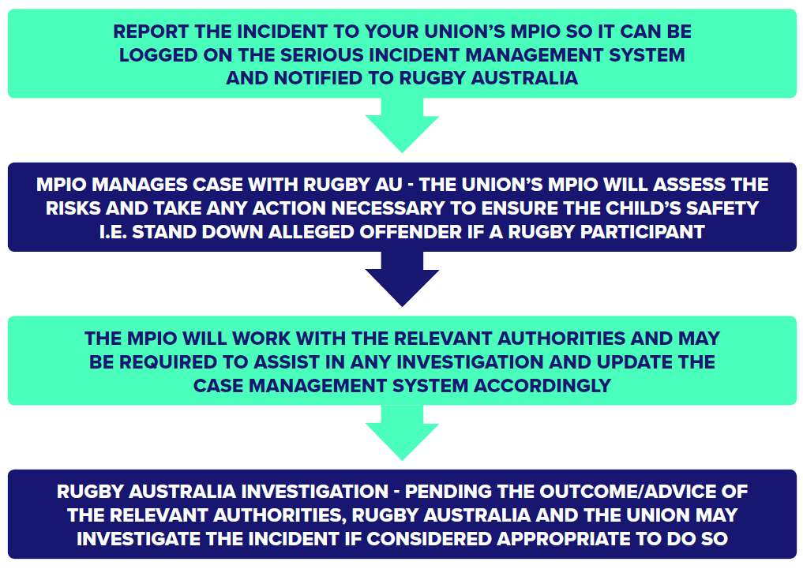

Slide 8
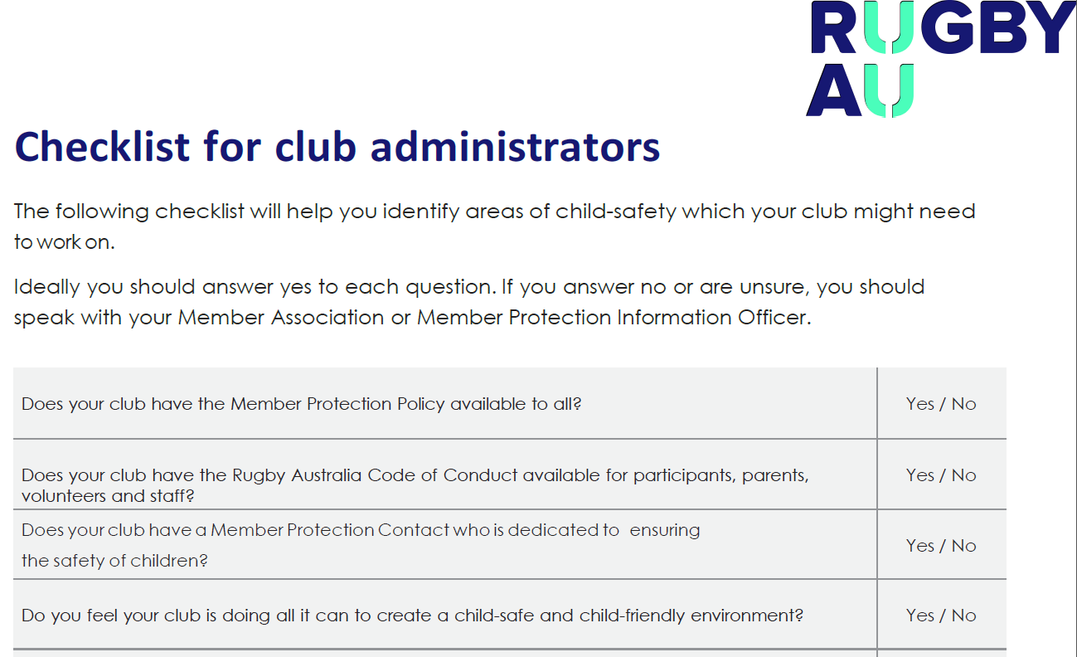

Slide 9
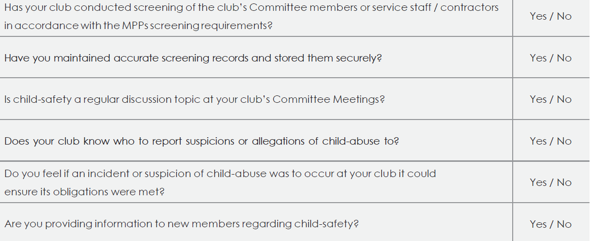

Slide 10
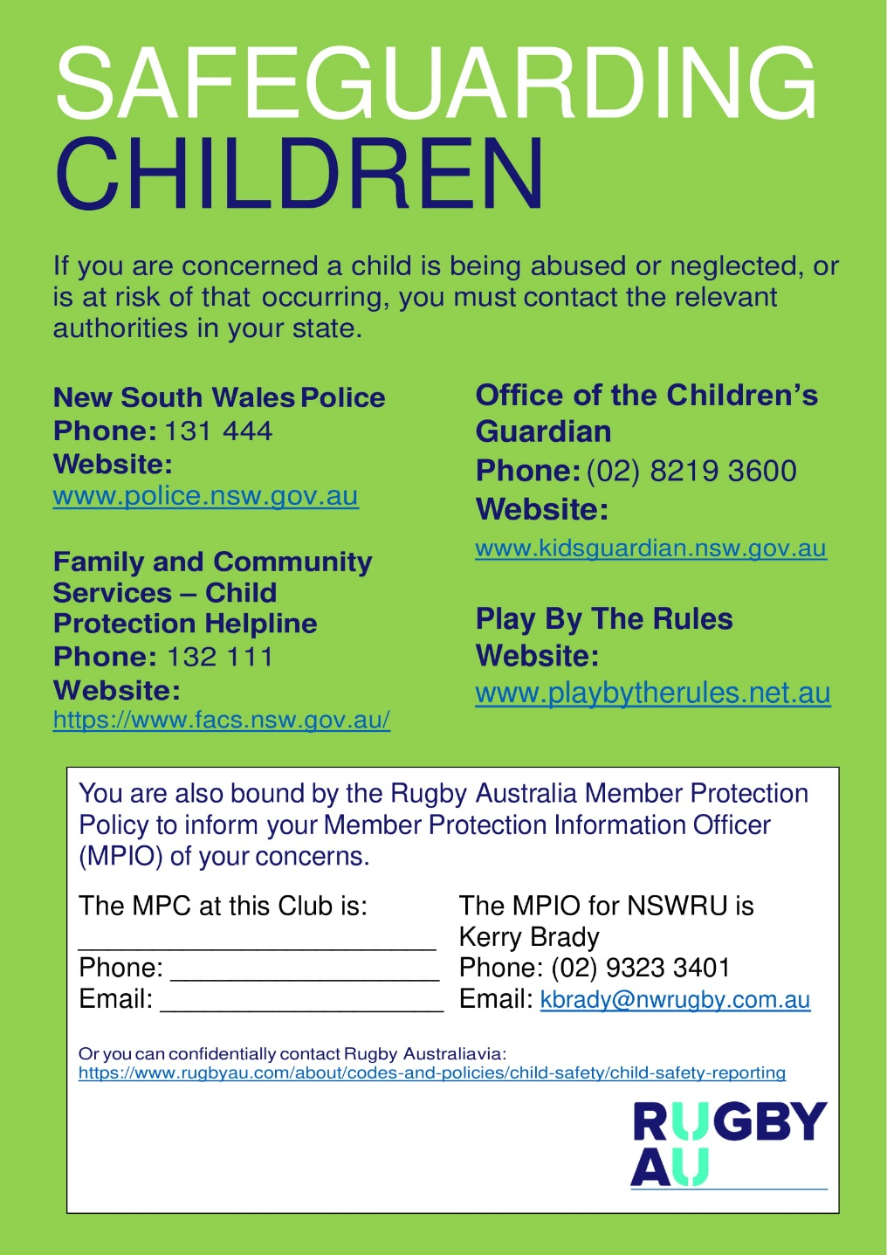
CHILD SAFETY RESOURCES FOR
CLUBS

Slide 11

FURTHER INFORMATION
Rugby Australia Policy Register http://www.rugbyau.com/about/codes-and-policies/all-codes-and-policies
Rugby Australia Safeguarding Children Webpage – http://www.rugbyau.com/about/codes-and-policies/child-safety
Your State or Territory Department of Child Safety
Play By the Rules https://www.playbytherules.net.au/

